Slide 1
AP Environmental Populations, Math, and Environmental Laws Review 1) Sign in by period 3) Solve math. Try not to use a calculator since you can’t use on May 5

Slide 2
Math Questions
A natural gas power plant is 60% efficient. If you cubic meter of natural gas provides 1000 BTUs of electricity. How many BTUs of waste heat were produced?
2) For crude oil if 150 pounds of CO2 is released per million BTUs of energy, how much CO2 is produced by each barrel of crude oil?

Slide 3
Math Answers
A natural gas power plant is 60% efficient. If you cubic meter of natural gas provides 1000 BTUs of electricity. How many BTUs of waste heat were produced?
Efficiency = Output / Input = 60% = 0.6 Energy Output = 1000 BTU of electricity So energy Input = 1000 BTU / 0.6 = 1667 BTU Waste heat produced = Energy Input - Energy Output = 1667 - 1000 BTU = 667 BTU
2) For crude oil if 150 pounds of CO2 is released per million BTUs of energy, how much CO2 is produced by each barrel of crude oil?
1 oil barrel = 158.987295 litres 1 oil barrel = 42 US gallons 1 oil barrel = 158.987295 litres 1 BTU = 252.164401 calories (6 * (10^6)) / 158.987295 = 37 738.8646 BTU (6 * (10^6) * 252.164401) / 42 = 36 023 485.9 cal 150*6=900 lbs of CO2

Slide 4
Math advice
-You get points for setting up the problem
-Try and cancel the units

Slide 5
The APES always has questions on energy so be prepared
1 Btu = 252 cal = 105⁵ J.
One therm is defined as 100,000 Btu, and natural gas at normal temperature and pressure has a heat value of 1,030 Btu/ft³. Thus, one therm is very nearly equal to 100 cubic feet of natural gas: 1 therm = 105 Btu / 1,030 Btu/ft³ = 97.1 ft³ ≈ 100 ft³.
1 kWh = 1,000 J/s x 3,600 s = 3.6 x 10⁶ J.

Slide 6
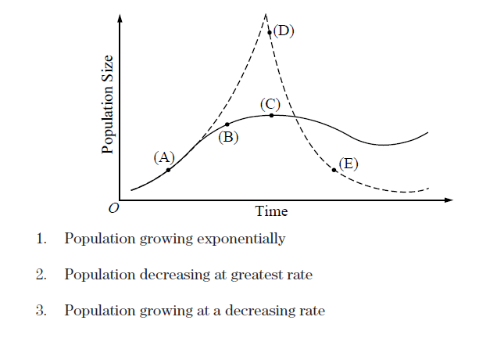
Populations

Slide 7
1) A 2) D 3) B

Slide 8
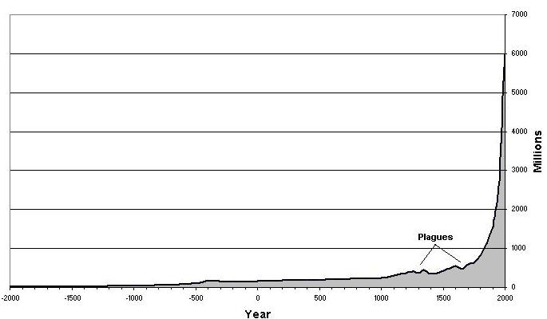
Population Growth
1804- 1 billion
1923- 2 billion (119 year doubling)
1974- 4 billion (51 year doubling)
2010- nearly 7 billion in 36 years

Slide 9
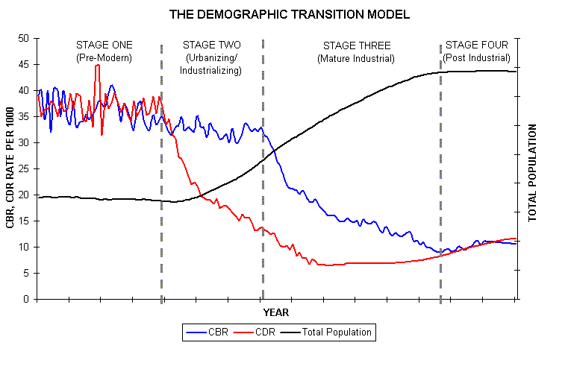
Demographic Stages
There are four recognized stages in the demographic transition from a pre-modern to a post industrial civilization.
Pre-industrial- birth and death rates high; population growth slow.
Industrializing or transition- high birth, lower death rates; increased population growth.
Industrialized- low birth and death rates; slowing population growth.
Post-industrial- population growth nearly or entirely stops.

Slide 10
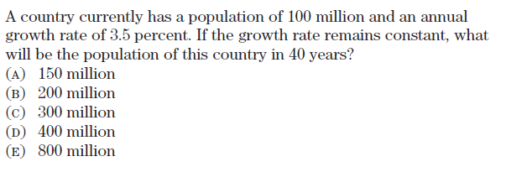

Slide 11
Answer D

Slide 12
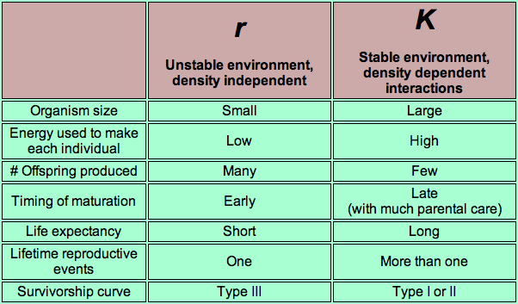

Slide 14
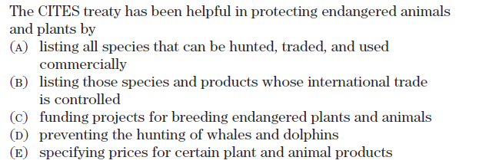
Environmental Laws

Slide 15
Answer: B

Slide 16
Laws saving Species
CITES--Convention on International Trade in Endangered Species prohibits trade in threatened or endangered species, whether animal, plants, or parts of animals or plants
Endangered Species Act, attempt to identify, list, and protect threatened or endangered species
52 - 16
Notes:
The link is to the FWS endangered species webpage: http://www.fws.gov/endangered/
398 U.S. species of animals are listed and 599 U.S. species of plants are listed
The ESA provides for habitat recovery plans and species recovery plans
Statistics on listed species current as of 2/10/06.
The ESA began and remains in controversy despite the obvious need for and apparent success of the law
According to the Sierra Club:
The U.S. has destroyed more than half its wetlands
The U.S. has logged 95-98% of its virgin forests in the lower 48 states
At least 80% of the coastline in the lower 48 states has been developed.
The Earth is losing up to 50,000 species per year (E.O. Wilson & Stephen Kellert, Eds., 1993. The Biophilia Hypothesis. Washington, DC: Island Press.).
CITES is an international version of the U.S. Endangered Species Act, requiring each nation to list threatened and endangered species and for each nation to protect the listed species from other nations. The link is to the CITES webpage.

Slide 17
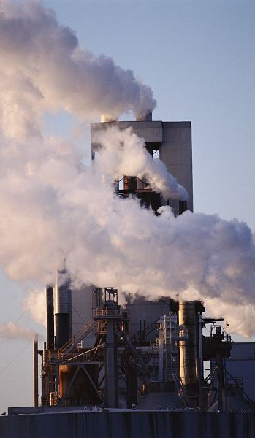
Air Pollution Programs
Primary law: Clean Air Act
Goal: improve National Ambient Air Quality through standards (NAAQS)
Focus is controlling pollution from mobile sources and stationary sources by issuing permits to polluters
Notes:
http://www.epa.gov/air/oaqps/peg_caa/pegcaain.html
The link is to the EPA website, The Plain English Guide to the Clean Air Act.
Mobile sources: vehicles. Stationary sources: industrial smoke stacks, light industrial operations (including drycleaners and restaurants).
Implemented by agency standards or rules
Air quality standards remain unchanged since 1978 when standards established for six criteria pollutants: lead, CO, VOCs, SO₂, particulates, and NO₂

Slide 18
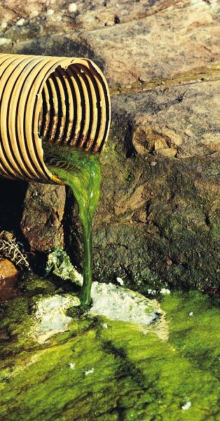
Clean Water Act
Clean Water Act (CWA) goals:
Ensure that navigable water is safe for drinking, fish & wildlife protection, and recreational use
Eliminate or limit discharge of pollutants into coastal and navigable inland waterways
Notes:
Link to the EPA presentation on the Clean Water Act at: http://www.epa.gov/watertrain/cwa/ The photo is an example of point source pollution.
Federal and state environmental agencies may enforce the Clean Water Act and water-related programs with civil fines and/or criminal penalties, including prison for those who knowingly violate the laws
See U.S. v. Hopkins
Citizens also may file suits to remediate or compensate for environmental harm
In U.S. v Hopkins, Robert Hopkins was Spirol’s vice president for manufacturing and falsified documents about compliance with an EPA consent decree. Hopkins was convicted following a jury trial and sentenced to 21 months in prison, with two years probation following that, and a $7,500 fine. Hopkins appealed, arguing that the government should have been required to prove that he intended to violate the law and that he had specific knowledge of the particular statutory, regulatory or permit requirements imposed under the Clean Water Act. The government contended that it was enough to prove that he had acted voluntarily or intentionally to falsify, tamper with, or render inaccurate a monitoring method—or to violate the permit—and that he did not do so by mistake, accident, or other innocent reason. The government was correct, of course!

Slide 19
Pesticides & Toxic Substances
Federal Insecticide, Fungicide, and Rodenticide Act (FIFRA) regulates use of pest control chemicals, from food growth to food packaging, to minimize presence of pesticides in consumable foods
Toxic Substances Control Act (TSCA) requires anyone planning to sell or market chemicals to first determine effect on human health and the environment
52 - 19
Notes:
FIFRA
About 350 pesticides are used on the foods we eat in the U.S.
See the EPA Citizen Guide to Pest Control & Safety at http://www.epa.gov/OPPTpubs/Cit_Guide/citguide.pdf
Other EPA fact sheets on pesticides are available at: http://www.epa.gov/pesticides/factsheets/health_fs.htm
TSCA
Gives EPA authority to track, investigate, or ban industrial chemicals currently produced or imported into U.S.
Not considered to be an effective law.

Slide 20
CERCLA
Comprehensive Environmental Response, Compensation, and Liability Act (CERCLA) of 1980, or Superfund, authorizes EPA to ensure clean-up and remediation of hazardous waste sites and assign liability for clean-up costs to any potentially responsible party (PRP)
Current owners or operators, former owners or operators, arrangers for treatment or disposal of hazardous substances, and transporters
Notes:
Superfund was created as part of a set of amendments (Superfund Amendments and Reauthorization Act of 1986) to be an “insurance” to cover remediation of sites where the PRPs were not identifiable or defunct.
In general, a law may not be retroactive, but CERCLA liability is retroactive and has been declared constitutional by the Supreme Court, meaning that parties may be held liable for releases that occurred prior to the enactment of the statute in 1980
See U.S. v. Domenic Lombardi Realty: a subsequent purchaser was held liable for cleaning up a property that had been contaminated, in part, by the actions of its predecessor in title.
Reason: entire purpose of law is to clean up past mistakes and protect human health
Check the photo gallery of the EPA Superfund site to see a number of “before and after” photos: http://www.epa.gov/superfund/action/process/sfgallry.htm
EPA may sue ALL PRPs. A PRP is defined as:
Current owners or operators of facility or vessel;
Former owners or operators of facility or vessel, if they owned the property at time of disposal;
Those who arrange for treatment or disposal of hazardous substances at a facility (usually the generators); and
Transporters of hazardous substances who selected the disposal site

