Slide 1


Fisheries

Slide 2
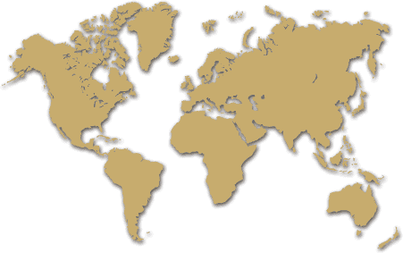
Worlds Major Fisheries
coastal areas
upwelling

Slide 3
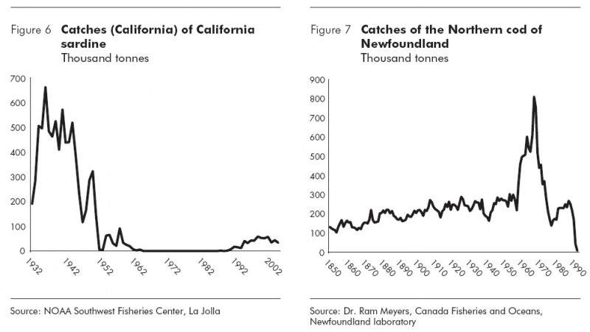
Collapse
Economy = $

Slide 4
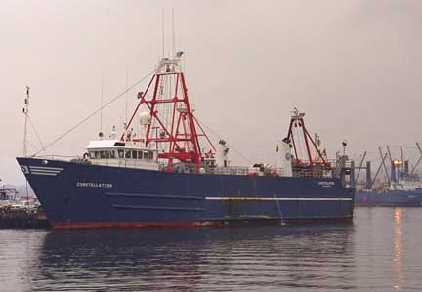
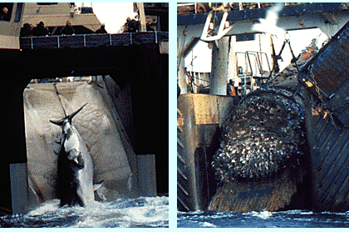
Commercial
500 species regularly caught
employs 15 million people worldwide
In 2005:
137 million tons taken
$70 billion

Slide 5
Global harvest (mmt)
Country 2000 2003 2006
________________________________________
China 11 15 14.8
Peru 8.9 8.4 10.6
Japan 5.9 5.1 4.9
United States 5.2 4.7 4.7
Chile 7.4 5.0 4.3

Slide 6
World per capita consumption of seafood in 2006 = 16.4 kg/yr
Problem?
U.S. per capita consumption of seafood in 2006 = 7.5 kg/yr
Notes:
World per capita consumption of seafood is about double that of the United States. Per capita consumption of seafood has not grown in the U. S. from 1985 and ranged between 6.5 and 7.5 kg/year. Seafoods are the principle source of animal proteins in many countries, most of these countries are located in Asia and Western Europe. For example, Japan and Norway consumed 66.9 kg and 49.5 kg of seafood/capita/year, respectively.

Slide 7
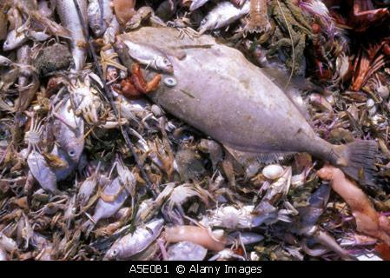
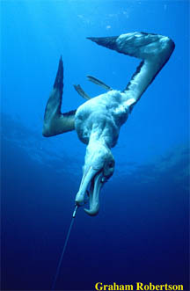
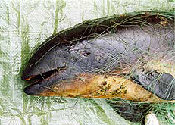
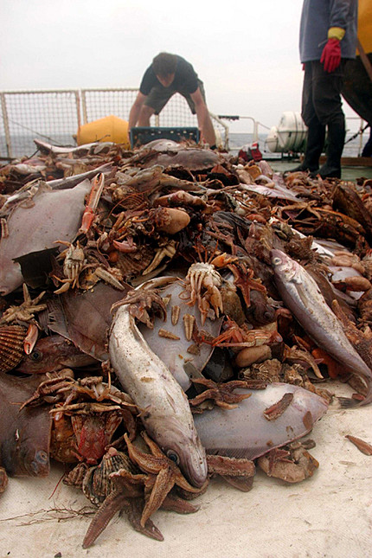
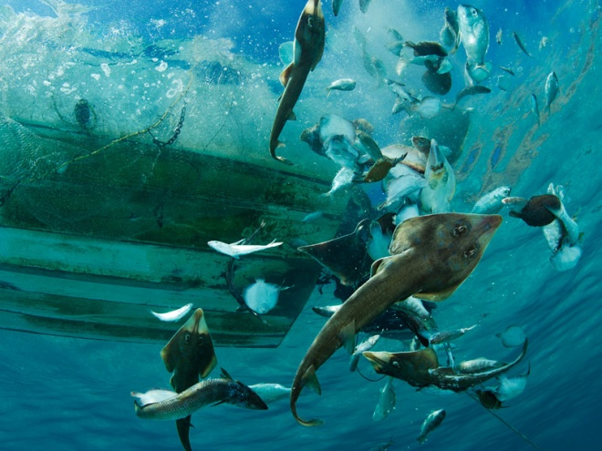
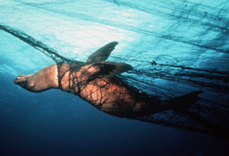
Fisheries Mismanagement
Overfishing
Commercial extinction
Bycatch (27 million metric tons annually)
Targeting smaller species on the low end of the food chain

Slide 8
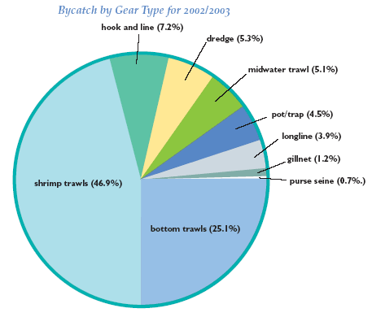

Slide 9
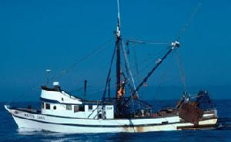
Fishing techniques

Slide 10
Methods
Harpoon - whales, swordfish, bluefin tuna
Pole and line - mahi-mahi and used for tuna extensively in the 50‘s
Longline - swordfish, tuna (pelagic); cod, halibut (bottom)
Trolling - salmon, albacore, mahi-mahi
Drift (gill) netting - various pelagic fish
Trawl - anchovies (pelagic); cod, halibut (bottom)
Purse seine - sardines, herring, mackerel
Traps and Pots - Crabs, lobster, rock fish

Slide 11
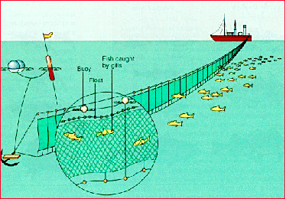
Gill/drift net
Notes:
A huge fleet of factory ships uses sophisticated electronic detection devices and aircrafts to find large schools of fish. Each ship then launches 20-50 fast, small catcher boats to set hundreds to thousands of miles of drift nets, weighted to stay at a desired depths. After drifting overnight, the nets are hauled in by the factory ships, and the catch is processed on board by canning or freezing. Large scale drift net fishing was banned in 1993, but it continues in the Pacific and has begun in the Atlantic.

Slide 12
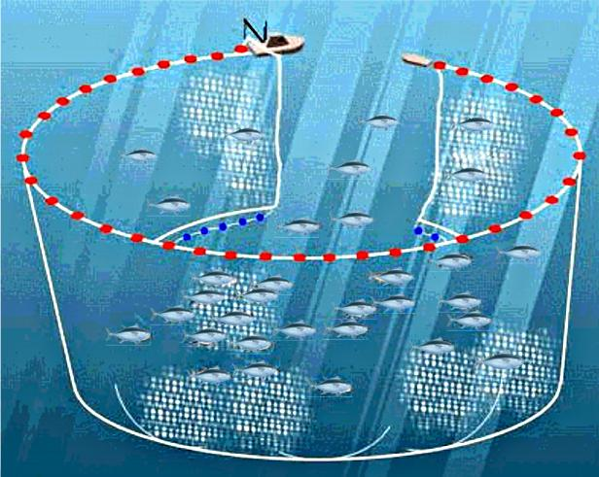
Purse seine

Slide 13
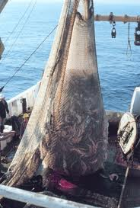
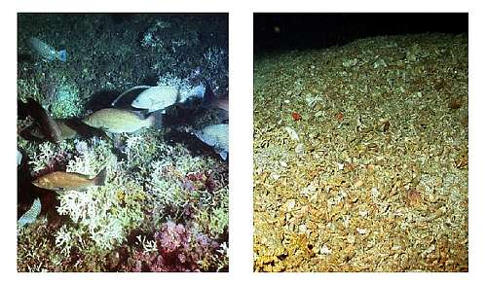
trawling
Video

Slide 14
Laws of the sea treaty
Allow nations to claim jurisdiction over their territorial seas (contiguous sea beds and their waters that extend off shore by 12 nautical miles)
Exclusive Economic Zone (EEZ)
200 nautical miles
under direct control of the country that owns the nearest land
Regulates continental shelf resources:
Fishing
Mineral exploration
Scientific research
Notes:
Due to rapid development of ocean drilling technologies, in 1958 & 1960 Geneva Convention- Law of the Sea--- regulation of continental shelf resources

Slide 15
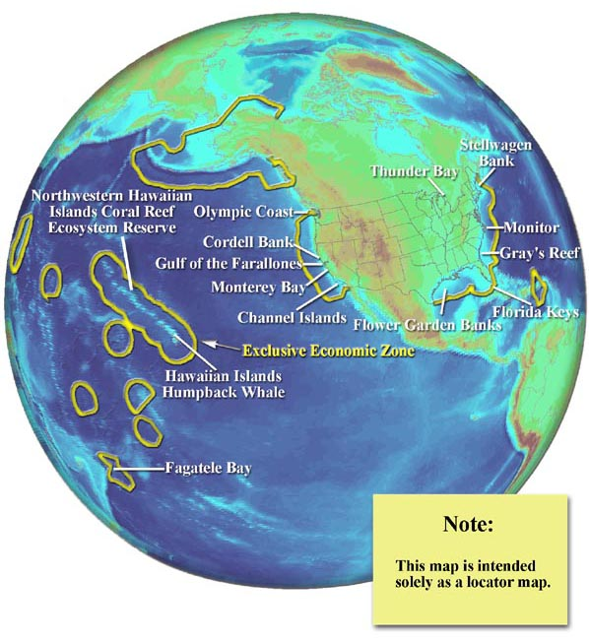

Slide 16
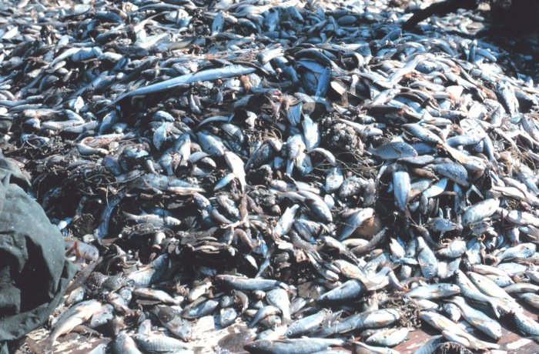
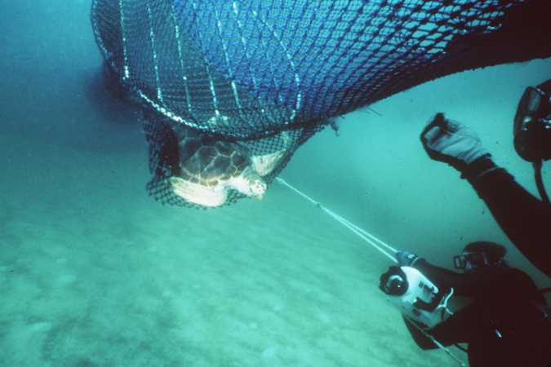
Possible solutions
Trawling: Bycatch in shrimp trawling is very high (25 to 83% of the catch is discarded), turtles often caught in trawls.
SOLUTION: trawls with trap doors to let turtles escape

Slide 17
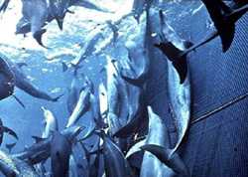
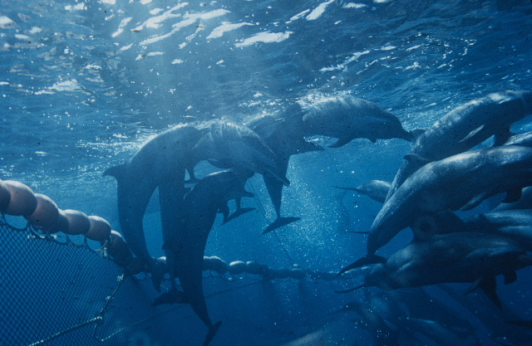
Possible solutions
Purse seine: Tuna known to hang out under pods of dolphins, nets set around pods of dolphins would result in many drowning.
SOLUTIONS: Nets not set around dolphin pods and/or employ — “backing down”, a technique that lowers upper edge of net letting dolphins escape

Slide 18
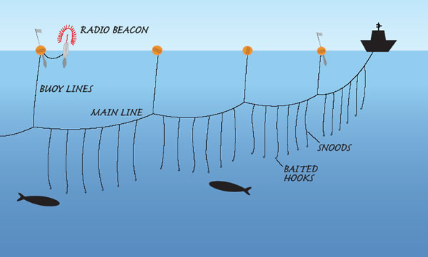
Possible solutions
Driftnets: indiscriminate entangling of many sorts of marine animals
SOLUTION: banned in oceanic fisheries (but some countries still using them)
Long lining: Many albatross drown trying to snatch bait from long lines being deployed. snagged on hooks and pulled under.
SOLUTION: deploy in the dark or with special rig to let line out under water.

