Slide 1
Take out Take Home FRQ and Land Use FRQ -Score and Reflection→Turn in
5,600,000 btus = 1 barrel of crude oil

Slide 2
Announcements
Today—Exit Quiz
Thursday—Review
Big Review ppt—on weebly
Mingle—Thurs Chapters 23, 15, 22
Posters—Monday
SATURDAY—Practice Test 8-11am

Slide 3
Acid Rain
Simpson’s Intro
https://www.youtube.com/watch?v=v09KnqiYi-c

Slide 4
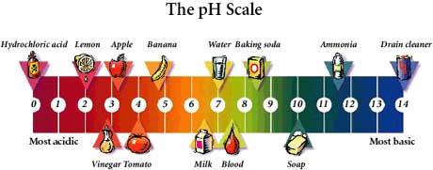

Slide 5
Two Forms…
Wet
Refers to acid rain, fog, sleet, cloud vapor and snow.
Dry
Refers to acidic gases and particles.

Slide 6
Compounds
Two main contributers to acid deposition:
Sulfur Dioxide (SO₂)
Nitrogen Oxides (NO_{x})
* 66% of all sulfur dioxides and 25% of all nitrogen oxides comes from electric power generation that produces energy by burning fossil fuels.

Slide 7
When gas pollutants e.g. sulphur dioxide, nitrogen dioxide dissolve in rain water, various acids are formed.
CO₂ + H₂O → H₂CO₃ (carbonic acid)
SO₂ + H₂O → H₂SO₃ (sulphorous acid)
NO₂ + H₂O → HNO₂ (nitrous acid) + HNO₃ (nitric acid)

Slide 8
Secondary Pollutants
H₂SO₄ HNO₂
sulfuric acid nitric acid
Primary Pollutants
SO₂
NO₂
acidic precipitation
vegetation
direct toxicity
indirect health effects
water
Fossil fuels
Power plants
Industrial emissions
Auto emissions
soils
leaching of minerals
sediments
leaching aluminum

Slide 9
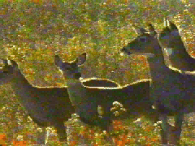
“Wet” Acid Rain
Acidic water flows over and through the ground
Affects a variety of plants and animals.

Slide 10
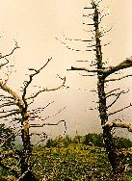
“Dry” Acid Rain
Dry deposition refers to acidic gases and particles.
About half of the acidity in the atmosphere falls back to earth through dry deposition.
The wind blows these acidic particles and gases onto/into buildings, cars, homes, and trees.
http://svr1-pek.unep.net/soechina/images/acid.jpg

Slide 11
Nutrients
Acidic water
dissolves the nutrients and helpful minerals in the soil
washes nutrients away before plants can use them to grow.
Acid rain also causes the release of substances, such as aluminum, that are toxic to plants

Slide 13
Effects on Wildlife
Generally, the young of most species are more sensitive to environmental conditions than adults.
At pH 5, most fish eggs cannot hatch.
At lower pH levels, some adult fish die.
Some acid lakes have no fish.

Slide 14
Effects on Wildlife
Both low pH and increased aluminum levels are directly toxic to fish.
Chronic stress that leads to lower
body weight
smaller size

Slide 15
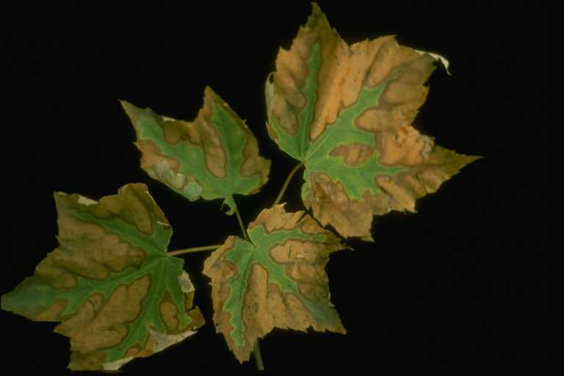
Acid Rain and Forests
Acid rain does not usually kill trees directly
Weakens trees
Damaging leaves
Limiting nutrients available
Toxic substances slowly released from the soil.

Slide 16
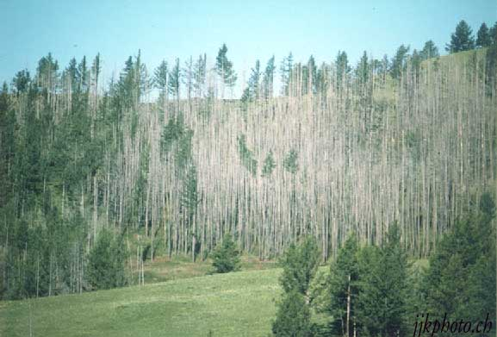
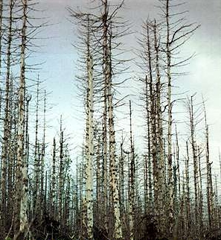
Mongolia
Germany

Slide 17
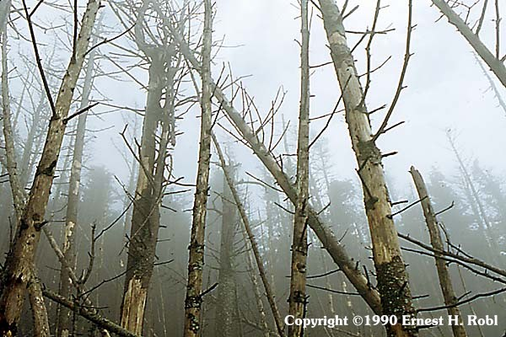
Great Smoky Mountains, NC

Slide 19
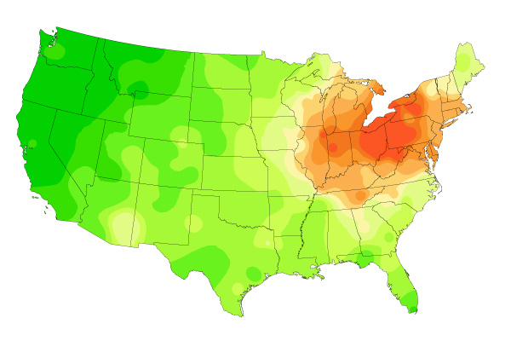
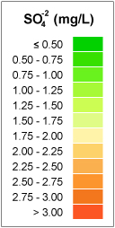
http://nadp.sws.uiuc.edu/amaps2/
Sulfate Ion Concentrations
1985-2004
1985
1984
1986

Slide 20
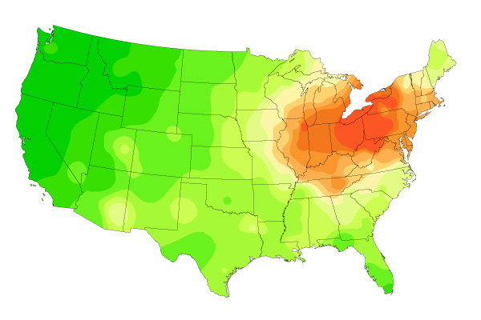
Sulfate Ion Concentrations
1985-2004
1986
1985
1987

Slide 21
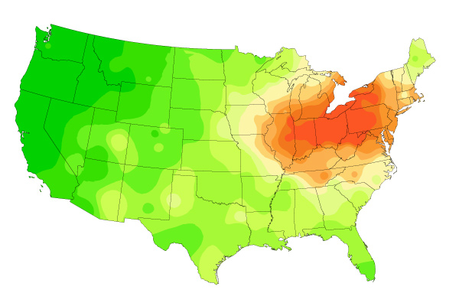
Sulfate Ion Concentrations
1985-2004
1987
1986
1988

Slide 22
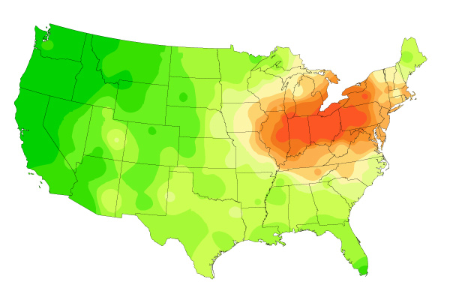
Sulfate Ion Concentrations
1985-2004
1988
1987
1989

Slide 23
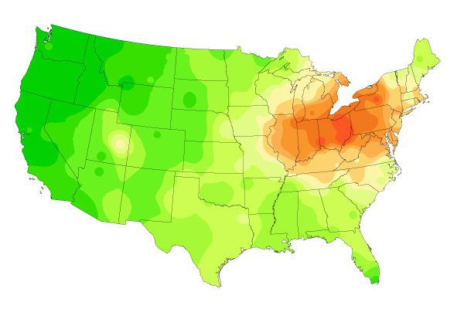
Sulfate Ion Concentrations
1985-2004
1989
1988
1990

Slide 24
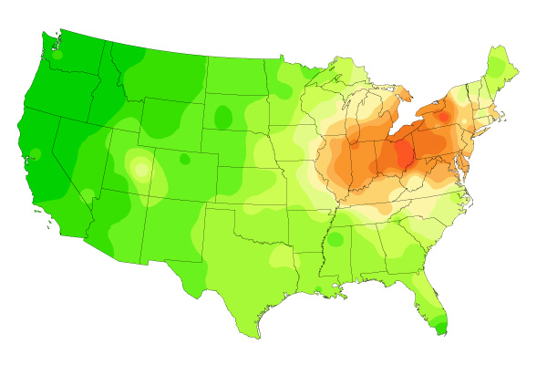
Sulfate Ion Concentrations
1985-2004
1990
1989
1991

Slide 25
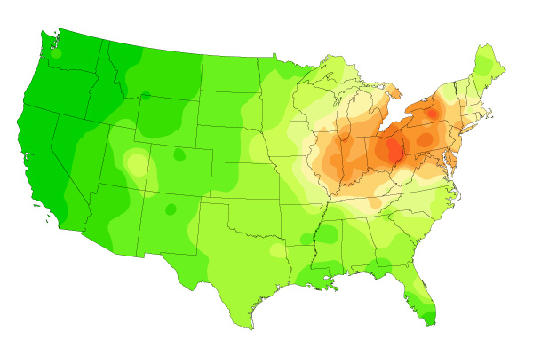
Sulfate Ion Concentrations
1985-2004
1991
1990
1992

Slide 26
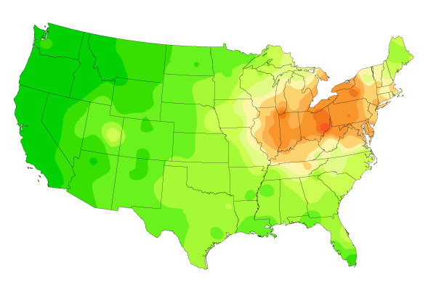
Sulfate Ion Concentrations
1985-2004
1992
1991
1993

Slide 27
Sulfate Ion Concentrations
1985-2004
1993
1992
1994

Slide 28
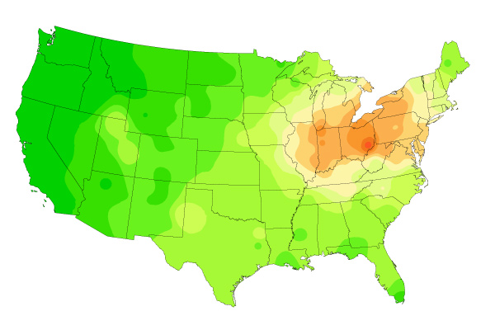
Sulfate Ion Concentrations
1985-2004
1994
1993
1995

Slide 29
Sulfate Ion Concentrations
1985-2004
1995
1994
1996

Slide 30
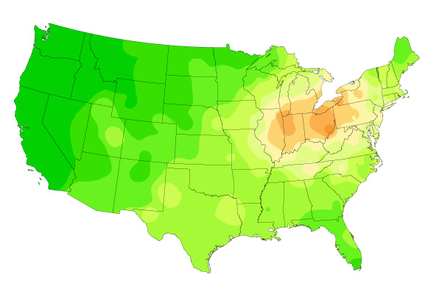
Sulfate Ion Concentrations
1985-2004
1996
1995
1997

Slide 31
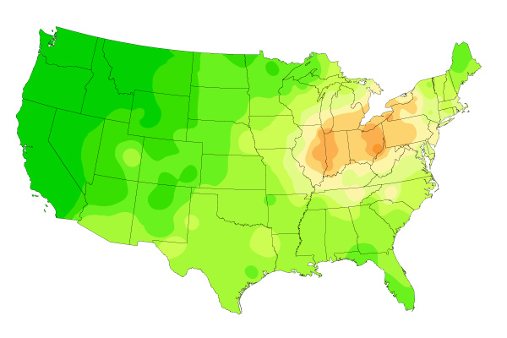
Sulfate Ion Concentrations
1985-2004
1997
1996
1998

Slide 32
Sulfate Ion Concentrations
1985-2004
1998
1997
1999

Slide 33
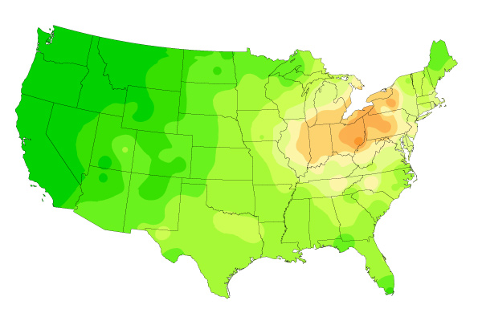
Sulfate Ion Concentrations
1985-2004
1999
1998
2000

Slide 34
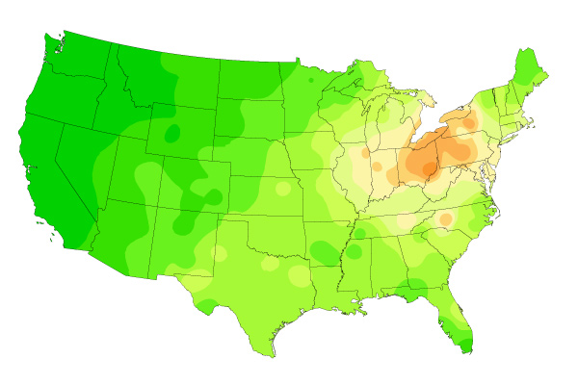
Sulfate Ion Concentrations
1985-2004
2000
1999
2001

Slide 35
Sulfate Ion Concentrations
1985-2004
2001
2000
2002

Slide 36
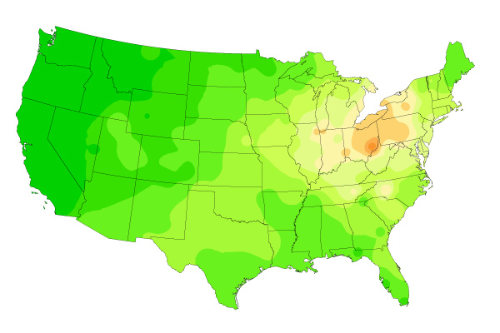
Sulfate Ion Concentrations
1985-2004
2002
2001
2003

Slide 37
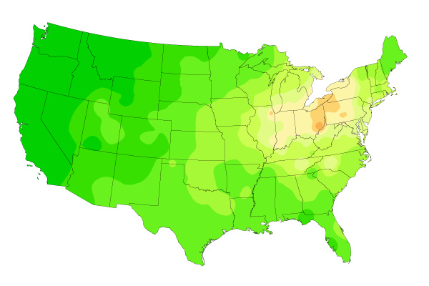
Sulfate Ion Concentrations
1985-2004
2003
2002
2004

Slide 38
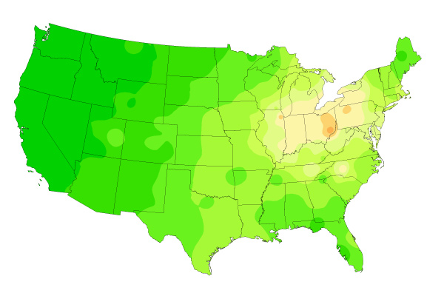
Sulfate Ion Concentrations
1985-2004
2004
2003
2005

Slide 39
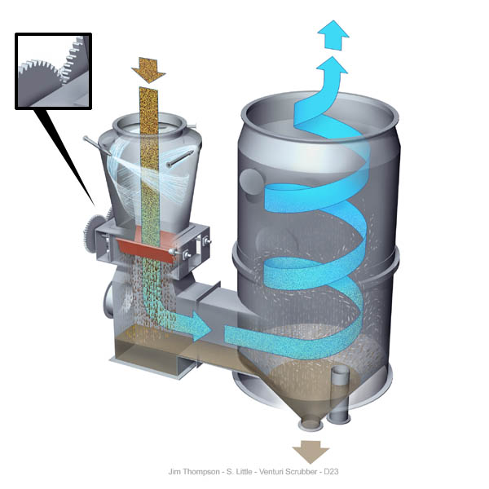
-Scrubber systems are a diverse group of air pollution control devices that can be used to remove some particulates and/or gases from industrial exhaust streams. -Scrubbers use limestone, one of the most commonly found substances in nature to clean air.

Slide 40
Make a Venn comparing
Acid Rain
Ozone Thinning
Greenhouse effect

Slide 41
Toxins
Fill in notes sheet

Slide 42
http://globalnews.ca/news/1248219/is-there-atrazine-in-your-drinking-water/

Slide 43
Key Questions
What types of hazards do humans face?
What chemical hazards do humans face?
What types of diseases threaten people in developing and developed countries?
How can risks be estimated and reduced?

Slide 44
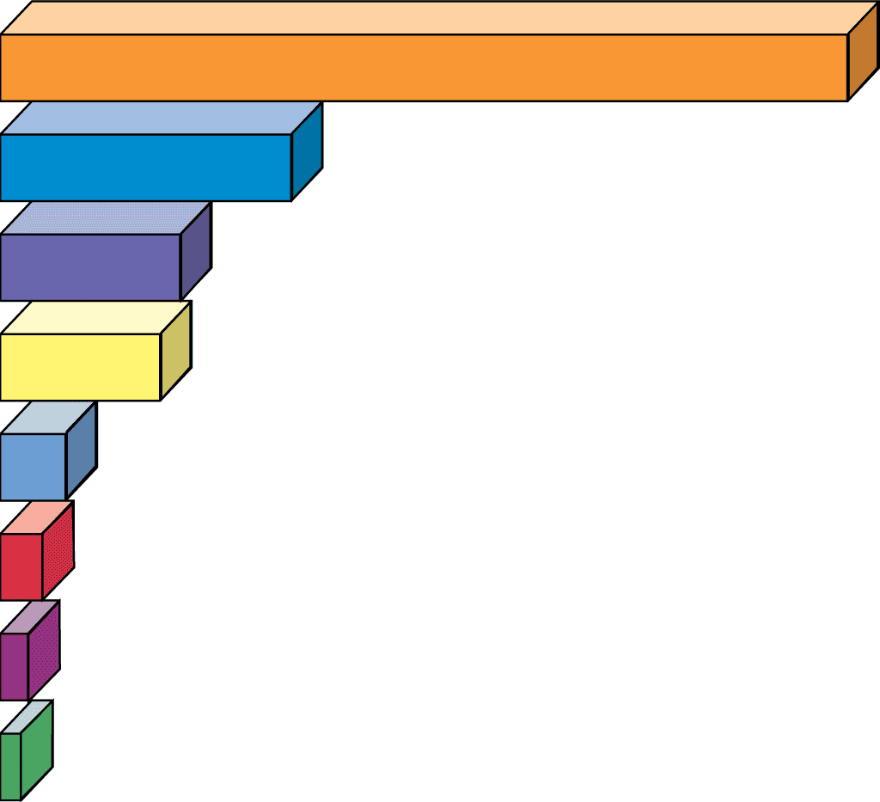
Cause of Death
Deaths
Tobacco use
440,000
Alcohol use
150,000
Accidents
95,600 (41,800 auto)
Pneumonia and
influenza
67,000
Suicides
28,300
Annual Deaths in the U.S.
Homicides
16,100
Hard drug use
15,600
AIDS
14,400
© 2004 Brooks/Cole – Thomson Learning

Slide 45
What Is a Risk?
The possibility of suffering harm from a hazard that can cause injury, disease, economic loss, or environmental damage
Expressed in terms of probability
Risk = Exposure x Harm

Slide 46
How Are Risks Assessed?
What is the hazard?
How likely is the event?
How much damage is it likely to cause?
Example: to assess the risk of exposure to a toxic chemical, you must look at the following:
Number of people/animals exposed
How long they were exposed
Age, health, sex, interaction with other chemicals, etc.

Slide 47
How Are Risks Managed?
How serious is the risk compared to other risks?
How much should the risk be reduced?
How can the risk be reduced?
How much money will be needed?

Slide 48
© 2004 Brooks/Cole – Thomson Learning
Risk Assessment
Risk Management
Hazard identification
What is the hazard?
Probability of risk
How likely is the
event?
Consequences of risk
What is the likely
damage?
Comparative risk analysis
How does it compare
with other risks?
Risk reduction
How much should
it be reduced?
Risk reduction strategy
How will the risk
be reduced?
Financial commitment
How much money
should be spent?

Slide 49
What Are the Major Types of Hazards?
Cultural Hazards: unsafe working conditions, poor diet, smoking, poverty
Chemical Hazards: harmful chemicals in the air, water, soil, food (human body contains about 500 synthetic chemicals whose health effects are unknown)
Physical Hazards: fire, earthquake, flood
Biological Hazards: allergens, bacteria, viruses, bees, poisonous snakes

Slide 50
What Determines Whether a Chemical is Harmful?
Size of dose over a certain period of time
How often an exposure occurs
Who is exposed (adult or child?)
How well the body can detox
Genetic makeup of the individual

Slide 51
Harm Can Also be Affected by…
Solubility: can the toxin get into the water supply?
Persistence: does not break down easily; long-lasting effects on people and animals
Bioaccumulation: molecules are absorbed and stored in organs or tissues at a high level
Biomagnification: some toxins are magnified as they pass through food chains
Chemical interactions: can multiply harmful effect of a toxin

Slide 52
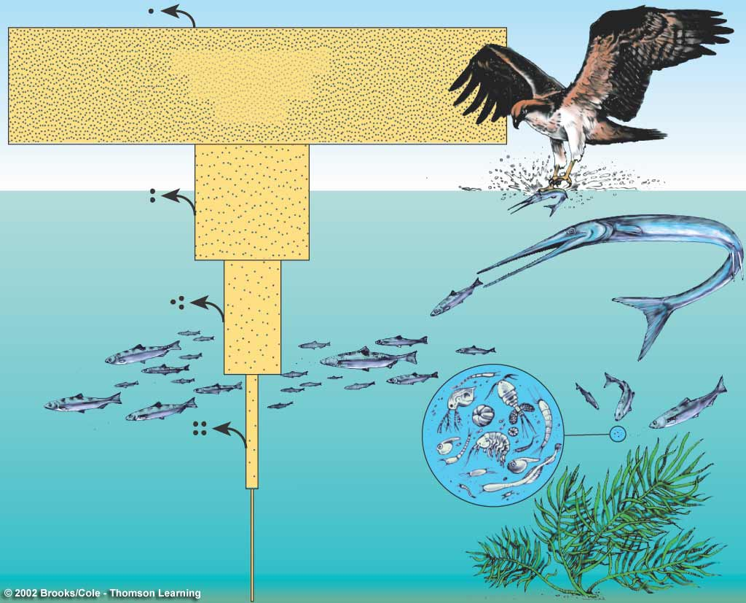
DDT in fish-eating
birds (ospreys)
25 ppm
DDT in large
fish (needle fish)
2 ppm
DDT in small
fish (minnows)
0.5 ppm
DDT in
zooplankton
0.04 ppm
DDT in water
0.000003 ppm,
Or 3 ppt
BIOACCUMULATION

Slide 53
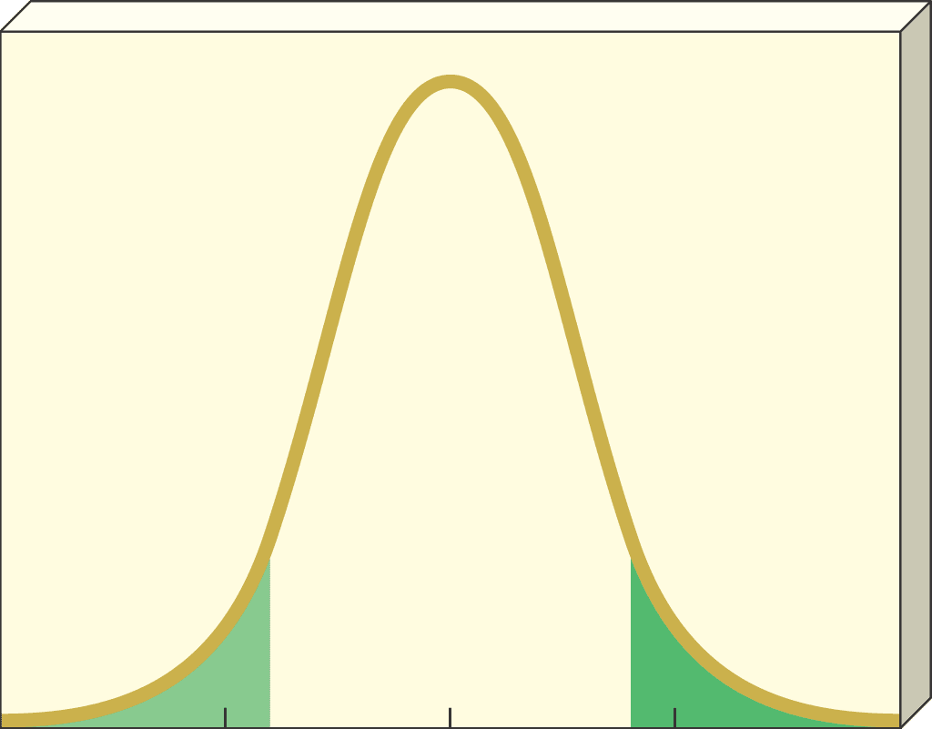
Variations in sensitivity due to genetic makeup
© 2004 Brooks/Cole – Thomson Learning
Majority
of population
Very
sensitive
Very
insensitive
Number of individuals affected
0
20
40
60
80
Dose (hypothetical units)

Slide 54
Response
Response: type and amount of health damage that results from exposure
Acute effect: immediate harmful reaction
Ex: dizziness or rash
Chronic effect: permanent, long-lasting consequence
Ex: kidney or liver damage

Slide 55
How Concerned Should We Be?
Most chemicals have threshold levels of exposure below which we are safe because…
Human body has ways of breaking down and diluting toxins
Cells have enzymes that repair damaged DNA
Some cells can reproduce fast enough to replace damaged cells

Slide 56
What is a Poison?
Poison: chemical that has an LD50 of 50 milligrams or less per kilogram of body weight
LD50: amount of a chemical that kills exactly 50% of animals

Slide 57
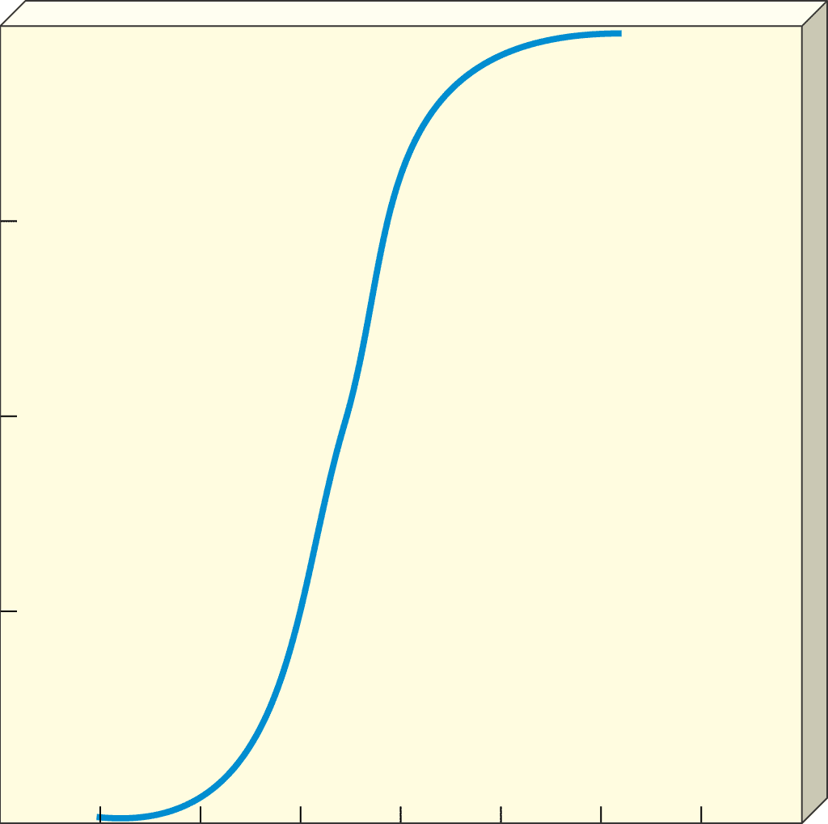
100
© 2004 Brooks/Cole – Thomson Learning
75
Percentage of population killed by a given dose
50
25
LD
50
0
8
2
4
6
10
12
14
16
Dose (hypothetical units)

Slide 58
How Do We Estimate Toxicity?
Case reports: accidental poisonings, drug overdoses, suicide attempts, etc.
Epidemiological studies: experiments where healthy people are exposed to a toxin

Slide 59
How Are Lab Experiments Used to Estimate Toxicity?
Use live laboratory animals
Cost $200,000-$2 million per substance
Dose-response curve—shows the effects of different doses of a toxin on a group of test organisms
Controlled experiments-compare test group to control group

Slide 60
Dose-response Models
Nonthreshold dose-response model: any dosage of a toxic chemical causes harm that increases with dosage
Threshold dose-response model: threshold dosage must be reached before any harmful effects occur

Slide 61
What are Toxic and Hazardous Chemicals?
Toxic chemicals: substances that are fatal to more than 50% of test animals
Hazardous chemicals: cause harm by being explosive, damaging to skin or lungs, interfering with oxygen, or causing allergic reaction

Slide 62
What are Mutagens?
Mutagens: agents that cause random mutations (changes) in DNA.
Example: mutations in sperm or egg cells can be passed on and cause bipolar disorder, cancer, hemophilia, Down Syndrome, etc.
Most mutations are harmless (DNA repair enzymes)

Slide 63
What are Teratogens?
Teratogens: chemicals, radiation, or viruses that cause birth defects during the first 3 months of pregnancy
Examples: PCBs, steriod hormones, heavy metals (lead, mercury)

Slide 64
What are Carcinogens?
Carcinogens: chemicals, radiation, or viruses that cause the growth of a cancerous (malignant) tumor—cells multiple uncontrollably and may spread by metastasis to other parts of the body
Cigarette smoke, occupational exposure, environmental pollutants, inheritance

Slide 65
How Can Chemicals Harm the Immune, Nervous, and Endocrine System?
Long-term exposure can affect these systems
Immune System: specialized cells and tissues that protect against disease and harmful substances by forming antibodies
Diseases such as HIV can weaken the immune system, leaving body vulnerable to allergens, bacteria, and viruses.
Nervous System: (brain, spinal cord, nerves)-many poisons are neurotoxins which attack nerve cells (DDT, PCBs, pesticides, lead, arsenic)
Endocrine System: (hormones for reproduction, growth, development, behavior)-hormonally active agents mimic and disrupt the effects of natural hormones

Slide 66
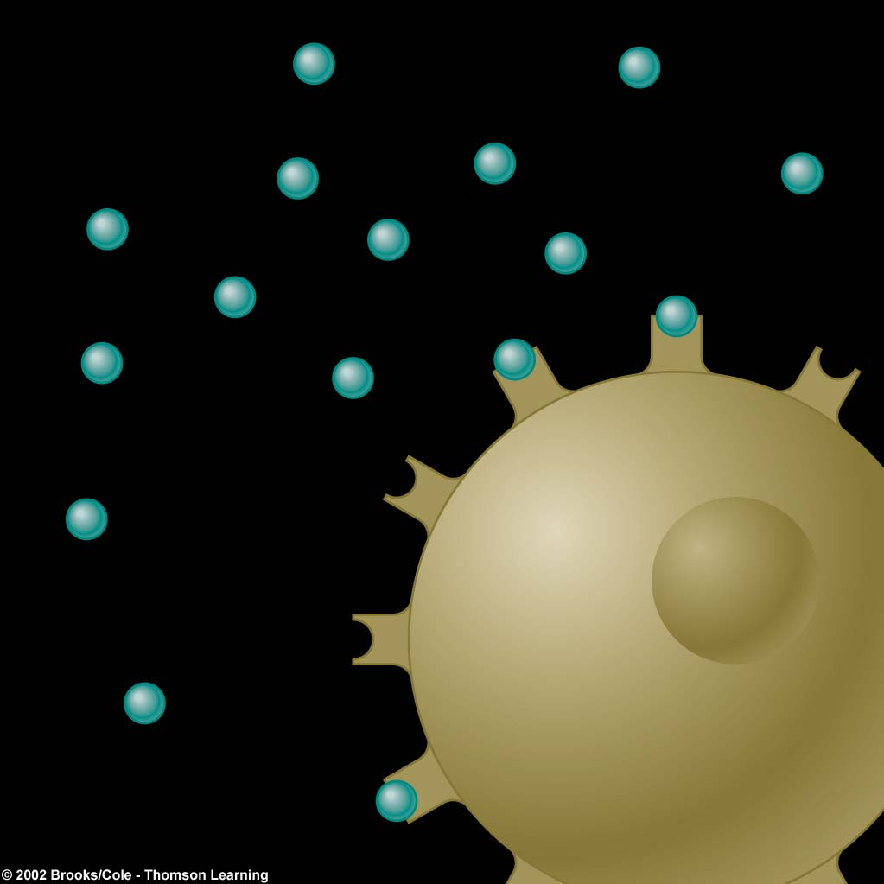
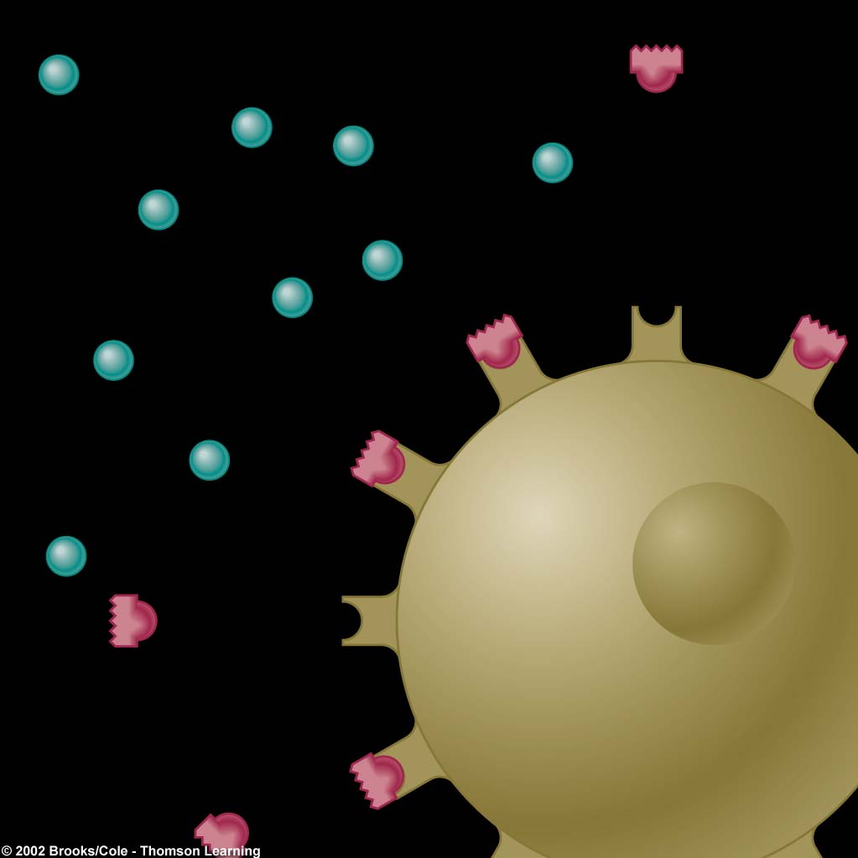
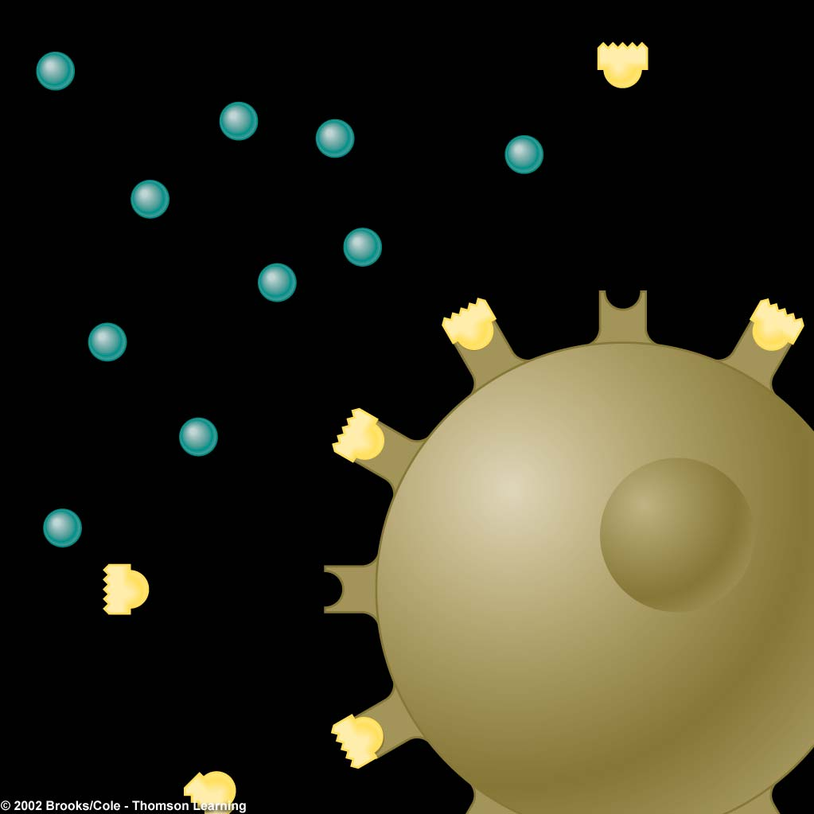
Hormone
Estrogen-like chemical
Antiandrogen chemical
Receptor
Cell
Normal Hormone Process
Hormone Mimic
Hormone Blocker

Slide 67
What is the Precautionary Approach?
When we are uncertain about the harmfulness of chemicals, decision makers should act to prevent harm to humans and the environment
“better safe than sorry”

Slide 68
How Can We Estimate Risks?
Identify hazards
Rank risks (comparative risk analysis)
Make decisions to reduce risks
Communicating to the public about risks
Most widely used method is benefit-cost analysis

Slide 69
How Well Do We Perceive Risks?
Most of us do poorly in assessing the risks from the hazards that surround us

Slide 70
Example
LD50 for toxin X is 200 mg/kg. How many milligrams would be lethal for a 100 lb adult?
1kg=2.2 lb

