Slide 1
Biomes
Biosphere is broken into several different biomes
Biomes can be land or water biomes
Biomes are separated by climate, plant, and animal life.

Slide 2
Land Biomes
Tundra
Taiga
Temperate Deciduous Forest
Tropical Rain Forest
Grassland
Desert
Chaparral
wetlands

Slide 3
Tundra
Soil frozen all year long
Top of the planet
Plants
Mosses/lichens
Animals
Snowy Owl, Caribou

Slide 4
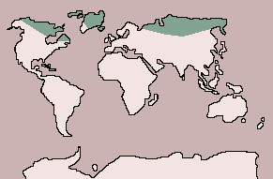
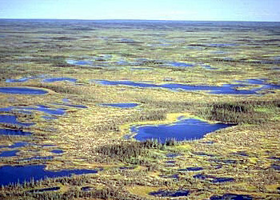
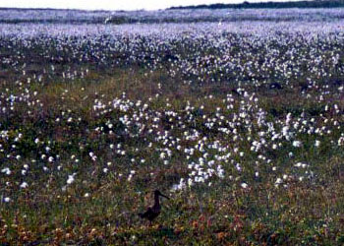

Slide 5
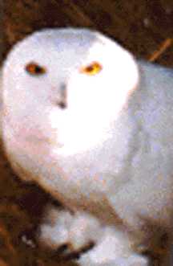
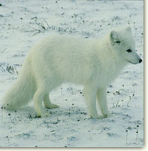
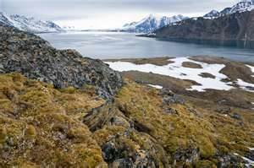
Snowy Owl
Arctic Fox

Slide 6
Environmental issues
Drilling for oil
Melting ice
Sensitive ecosystem

Slide 7
Taiga
Long severe winters
ACIDIC SOIL
Low to med precipitation 20-60 cm
Animals
Moose, Black Bear, grizzly
Plants
Conifers (Christmas trees)

Slide 8
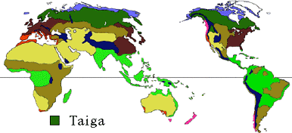
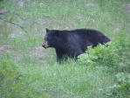

Slide 9
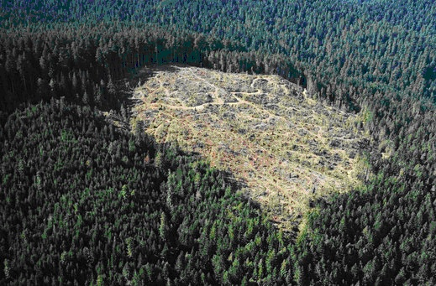
Environmental issues
Logging/clearcutting
Mining
Acid rain

Slide 10
Temperate Deciduous Forest
Cold winters and warm summers (this is the type of forest in new york)
Up to 250 cm or precipitation (a lot)
Animals
Squirrel, fox, deer, rabbits
Plants
Trees that drop leaves in the fall (maple, oak, elm)
Soil is rich due to leaves dropped!

Slide 11
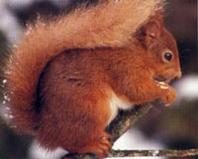
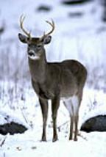
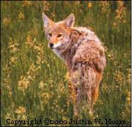
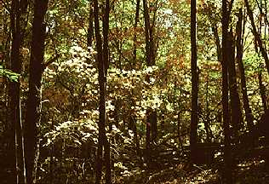

Slide 12
Environmental issues
Logging/clearcutting
Fracking!
Acid rain

Slide 13
Tropical Rain Forest
Heavy Rainfall, Always warm
POOR quality soil –everything is recycled
Animals
Snakes, monkeys, leopards, (basically all the cool jungle animals you see on TV)
Plants
Ferns, bamboo, broad leaf plants

Slide 14
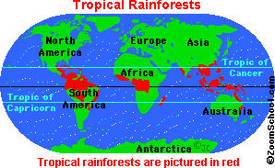
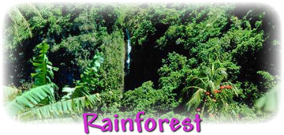
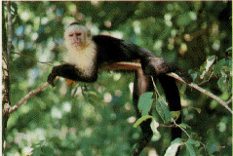

Slide 15
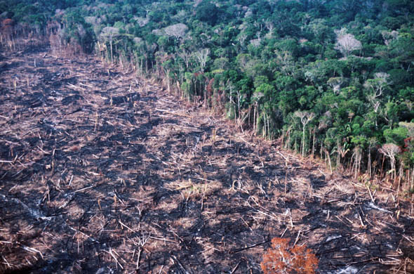
Environmental issues
Clearcutting for farms
Loss of species
Soil destruction
desertification

Slide 16
Grassland
Rainfall and temperature vary generally 10-60 cm
Rich Soil
Animals
Prarie dog
bison
Lions, zebras, giraffes
Plants
grasses

Slide 17
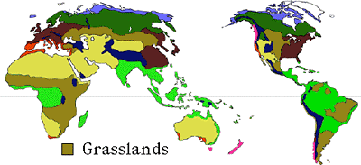
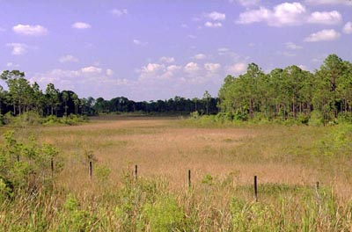
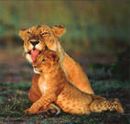

Slide 18
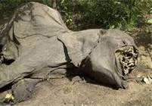
Environmental issues
Poaching
Farming destroys soil

Slide 19
Desert
Very little rainfall
High daily temperatures, low nightly temperatures
Animals
Rats, lizards, snakes
Plants
cactus

Slide 20
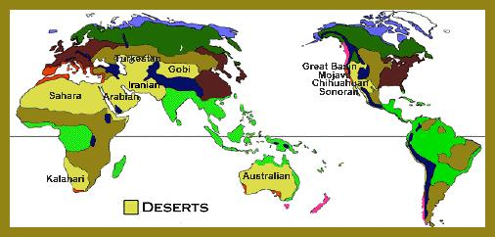
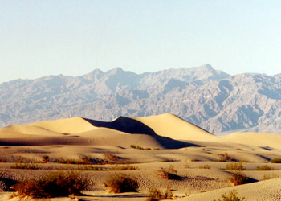
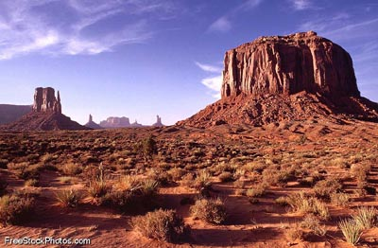

Slide 21
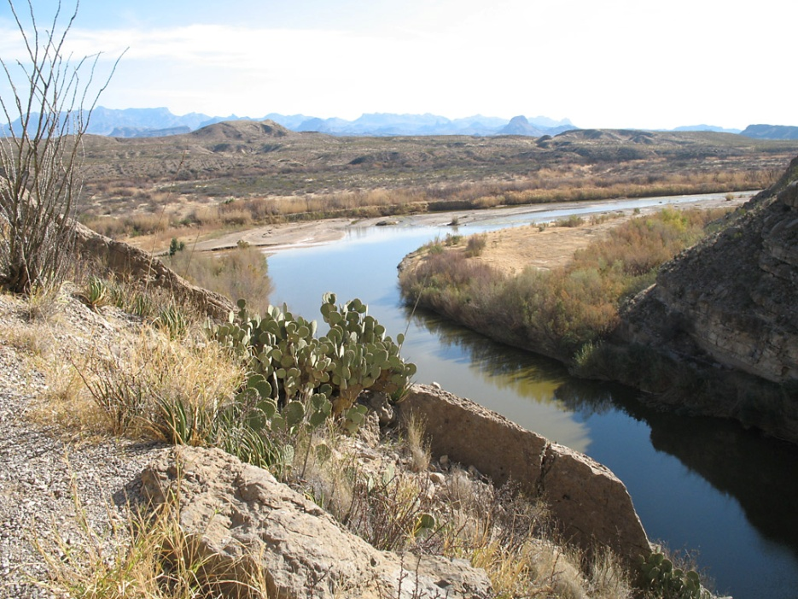
Environmental issues
Water!
Sensitive ecosystem

Slide 22
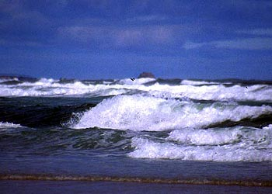
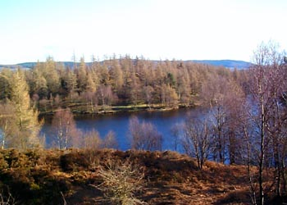
Water Biomes

Slide 23
Aquatic (Water) Biomes
70% of the earth is covered in water
Amount of dissolved oxygen, carbon dioxide, temperature, light and minerals effect the water biomes
2 types of aquatic biomes
Saltwater (oceans)
Freshwater (Ponds, lakes, streams, rivers)

Slide 24
Oceans
Hold heat and help to stabilize the earths atmosphere.
Much of photosynthesis is carried on in the oceans
Have a large variety of temperatures and animals

Slide 26
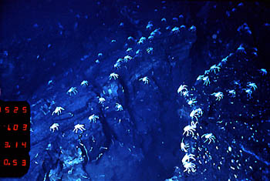
Deep Sea Vent Creatures

Slide 27
Freshwater Biomes
Ponds, lakes, streams, rivers.
Temperature and animal life vary greatly
Found all over the world

Slide 28
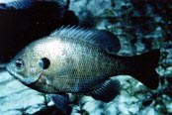
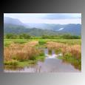
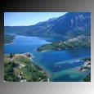
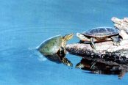
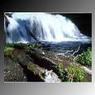
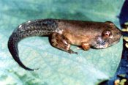

Slide 29
Wetlands!
Standing water covers the ground- not connected to the ocean
Many many plants- floating plants,
Anphibians, leeches, snakes, birds

Slide 30
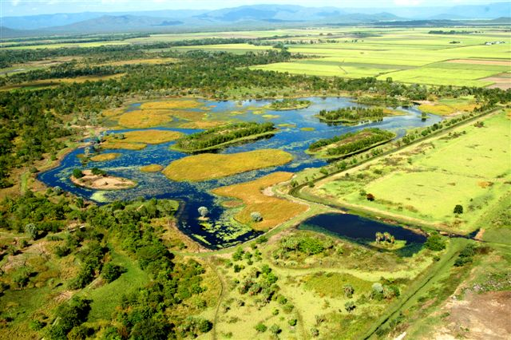
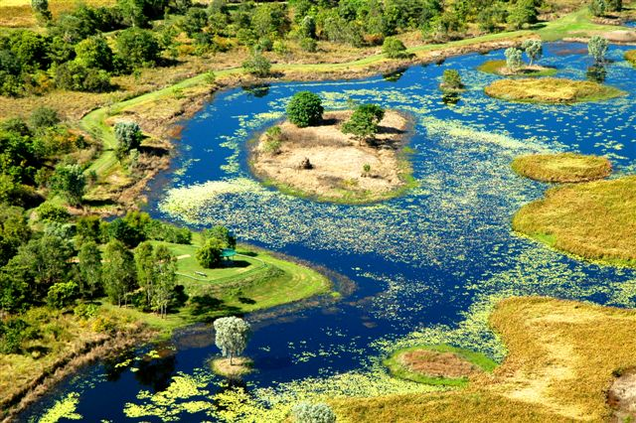

Slide 31
Environmental issues
Provide flood protection so when destroyed floods are caused.

